Slide 1
SURVEY OF ACTIVE/RETIRED MILITARY MEMBERS AND THEIR FAMILY ON HEALTH
LEARN MORE

Slide 2
THE PMW FOUNDATION
The PMW Foundation is a 501(c)(3) organization dedicated to providing support, education, and outreach for veterans in the United States, starting from the time of separation.
Through collaborations, partnerships, and culturally relevant educational initiatives, the foundation aims to empower veterans by providing information on benefits and opportunities.

Slide 3
SURVEY PROTOCOL
Developed and revised several draft surveys for review
￭Conducted small focus group of retired (6), active (2) and family members (9) target group for initial feedback and fielding of the survey.
￭Revised draft x 2.
￭Pilot distributed to targeted group of the revised survey via electronic and in person methodology.
￭Final survey completed.
Research completed on subject areas with specific focus on existing surveys or published expert opinions in this area.
Developed an SOP based
on best practices.
Final surveys fielded using database and dissemination to target list. Survey executed per SOP with resultant scientifically sound analysis and report.

Slide 4
METHODOLOGY & RESULTS
⚬ One of the largest scientifically conducted surveys of African American Military and Military Connected Persons (over 91.67% AA respondents and 8.33% other biracial (AA/White).
⚬ SurveyMonkey
￭ Program used to create and distribute survey
Printed surveys also provided and input by staff for analysis
All results were confidential and aggregately reported
⚬ Final Survey distributed from Sept. 1, 2023, to Nov. 1, 2023
⚬ 1004 validated respondents:
￭ Online: 718
￭ Printed: 286
￭ Eliminated incomplete surveys 22 (online 13 printed 9)

Slide 5
QUESTIONS 1-3 IDENTIFIERS/DEMOGRAPHICS
6

Slide 6
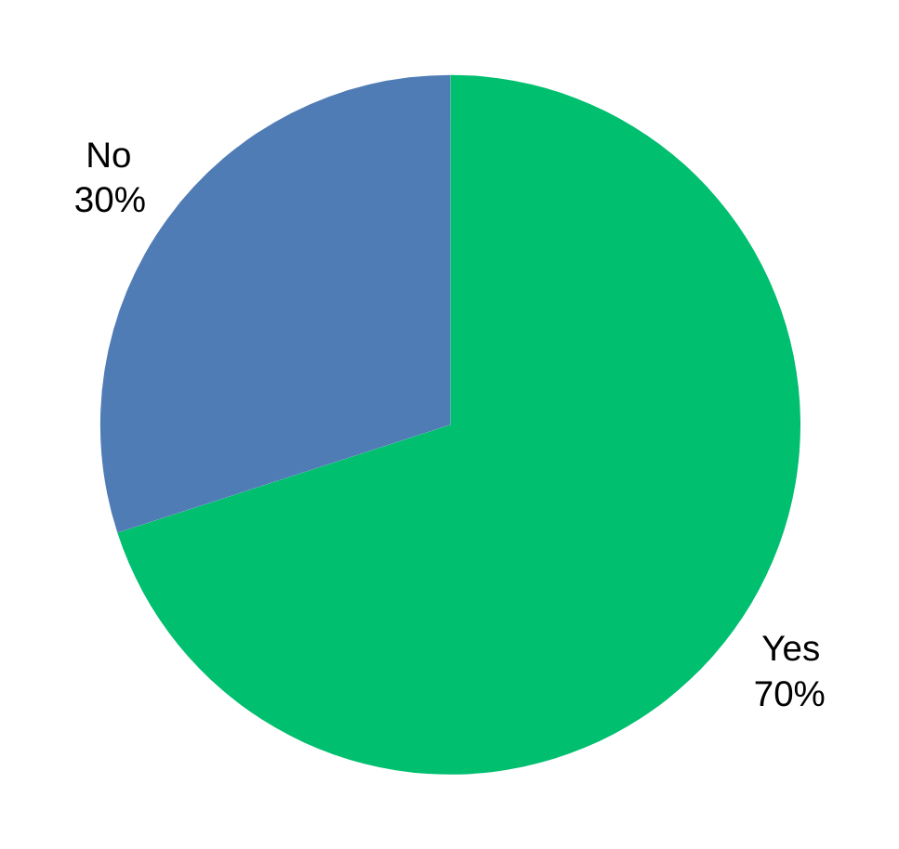
Q4: DID YOU SERVE OR ARE YOU SERVING IN THE MILITARY OF THE UNITED STATES?

Slide 7
Q5: IF NO; DID (INCLUDING ACTIVE DUTY NOW) A MEMBER OF YOUR IMMEDIATE FAMILY SERVE?
24.8 % of respondents were in this category
(family member served)
100% indicated YES
to Q5 *
*Eliminated/Automatically disqualified any respondent who answered NO as they were not the target audience.

Slide 8
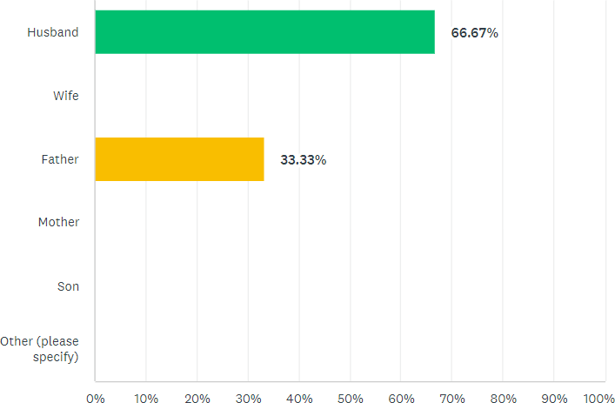
Q6: IF YES, WHAT IS THE RELATIONSHIP?

Slide 9
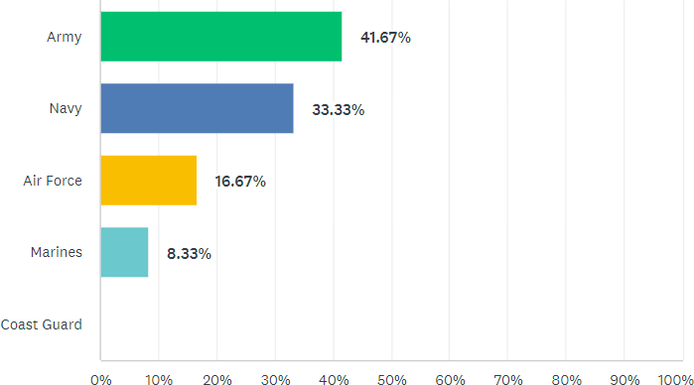
Q7: WHAT BRANCH OF THE MILITARY SERVICE WERE/ARE YOU OR YOUR SPOUSE OR RELATIVE(S) AFFILIATED WITH?

Slide 10
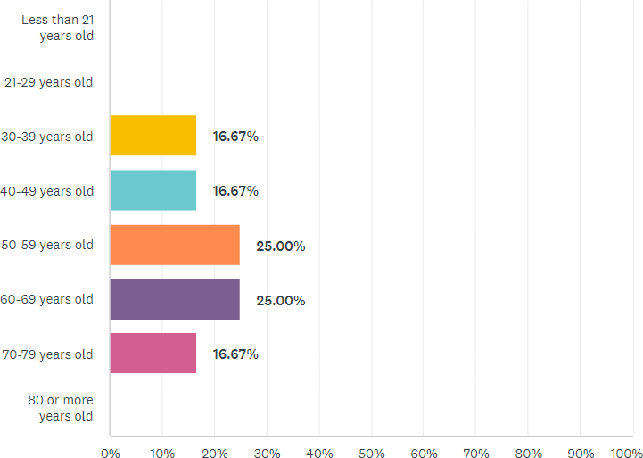
Q8: WHAT IS YOUR AGE GROUP?

Slide 11
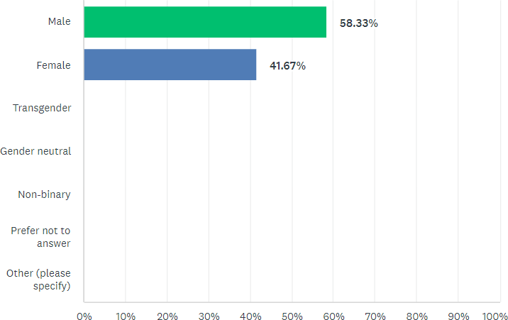
Q9: WHAT IS YOUR SEX/GENDER?

Slide 12
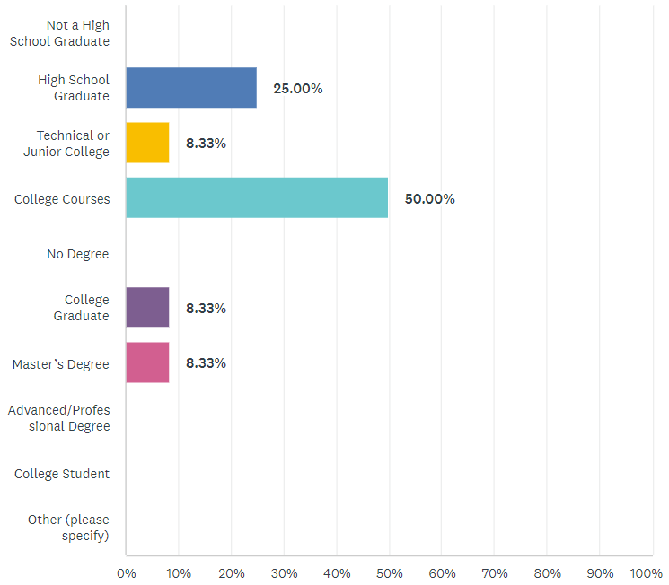
Q10: WHAT BEST DESCRIBES YOUR HIGHEST COMPLETED LEVEL OF EDUCATION?

Slide 13
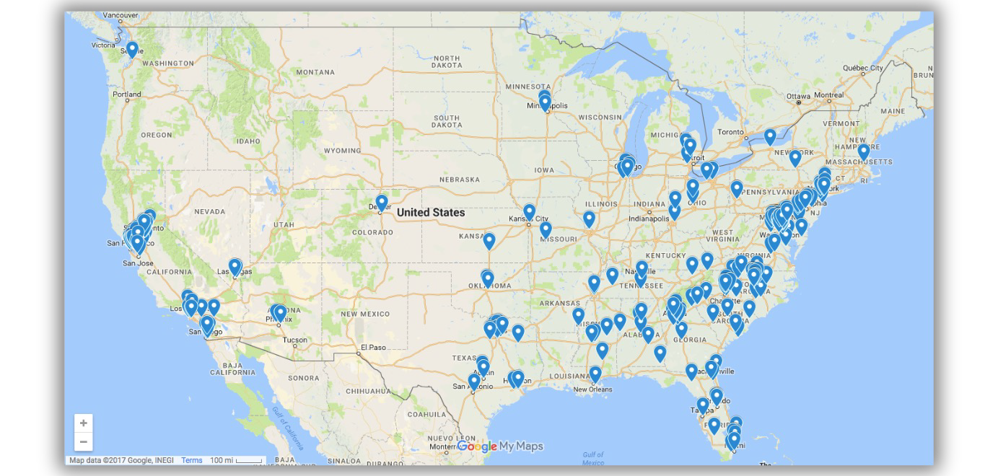
Q11: WHERE DO YOU CURRENTLY LIVE?

Slide 14
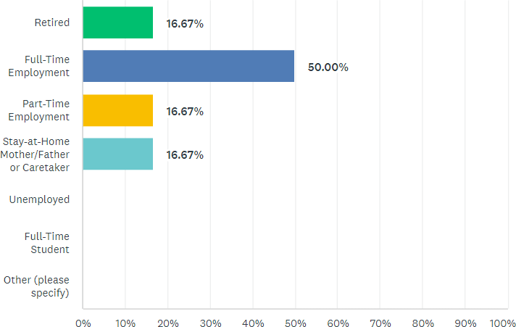
Q12: WHAT IS YOUR EMPLOYMENT STATUS?
thepmwfoundation.org

Slide 15
Q13: WHAT IS YOUR SPECIFIC OCCUPATION?
(i.e. TEACHER, CONSTRUCTION WORK, ACCOUNTANT, NURSE, ADMINISTRATIVE ASSISTANT, etc)
DATA WAS COLLECTED BUT NOT REPORTED
thepmwfoundation.org
IN THIS PRESENTATION.

Slide 16
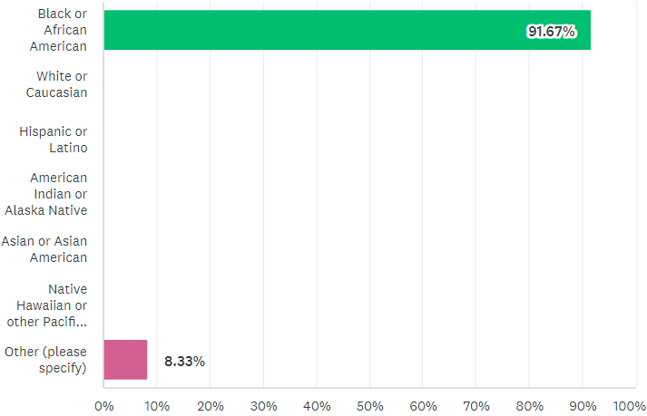
Q14: WHAT IS YOUR ETHNICITY/RACE?
thepmwfoundation.org
Powered by

Slide 17
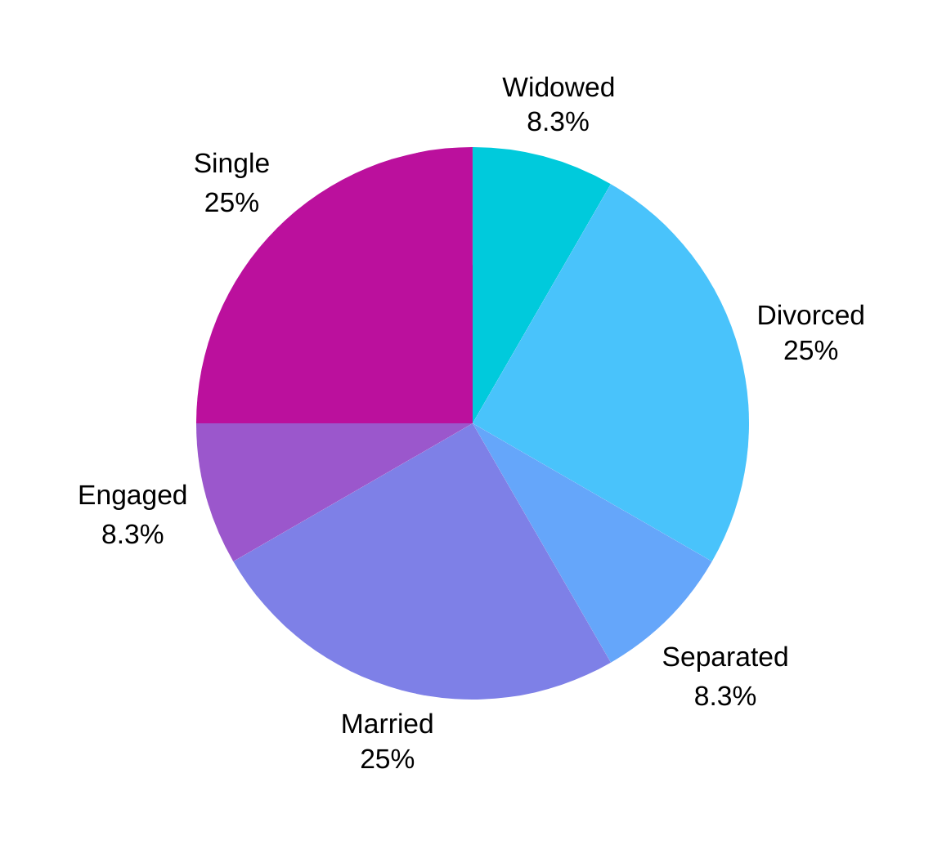
Q15: WHAT IS YOUR MARITAL STATUS?

Slide 18
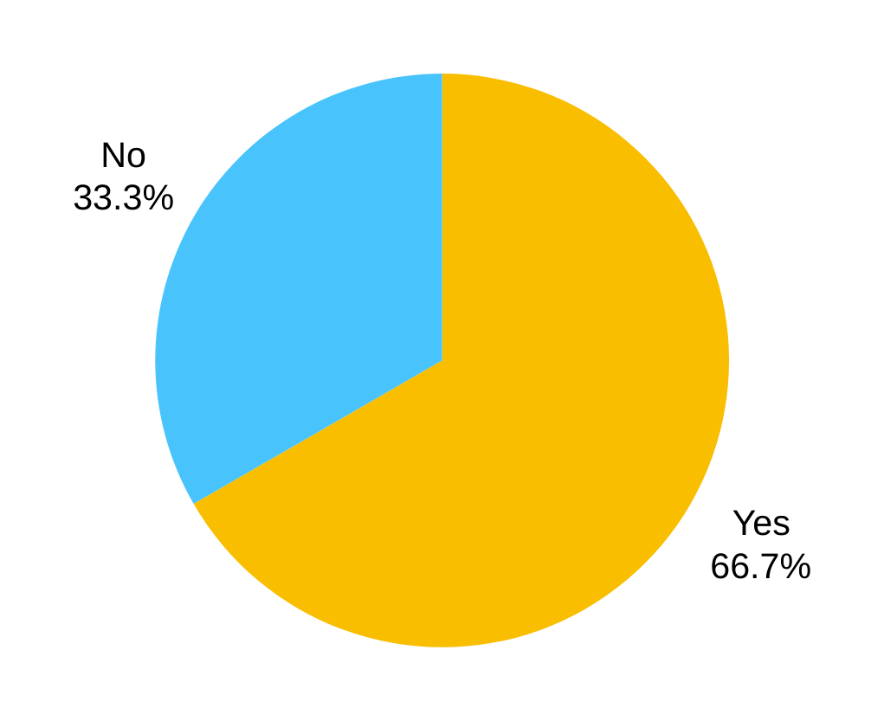
Q16: DO YOU HAVE CHILDREN?
Powered by

Slide 19
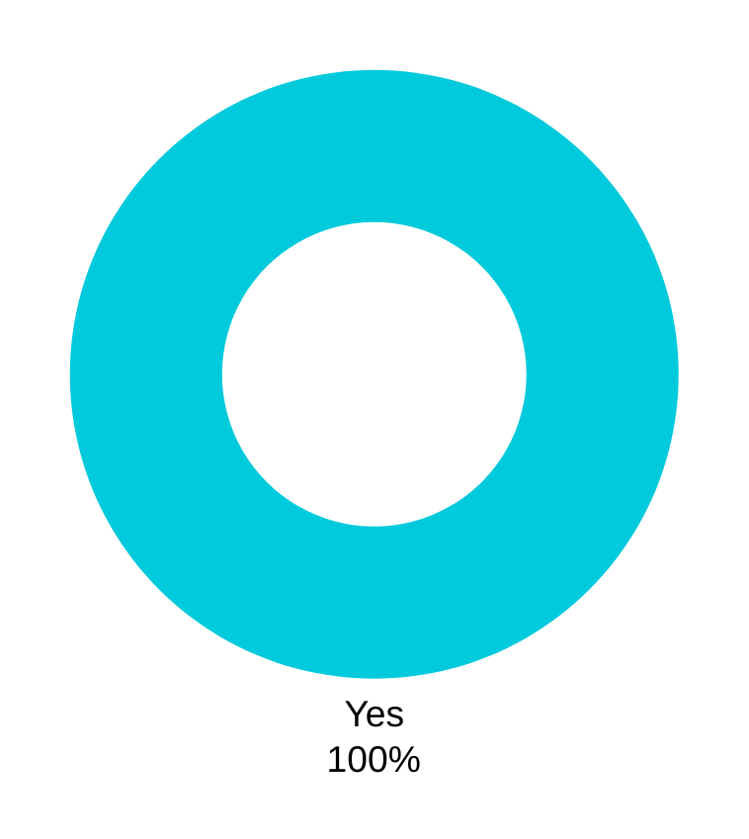
Q17: DO YOU HAVE HEALTH INSURANCE?

Slide 20
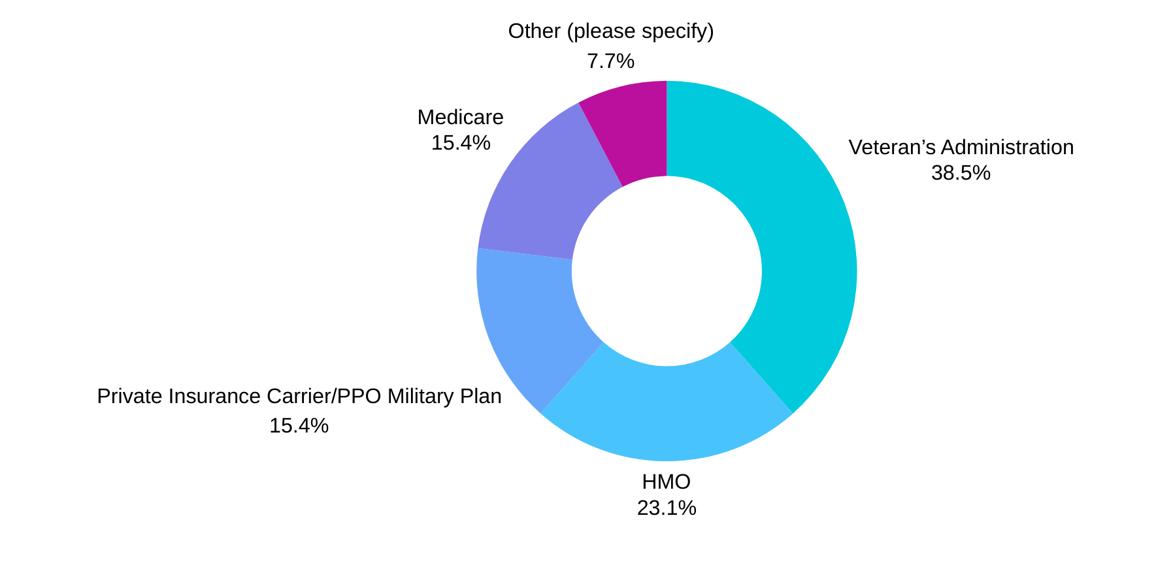
Q18: WHAT TYPE OF HEALTH INSURANCE DO YOU HAVE?
Powered by

Slide 21
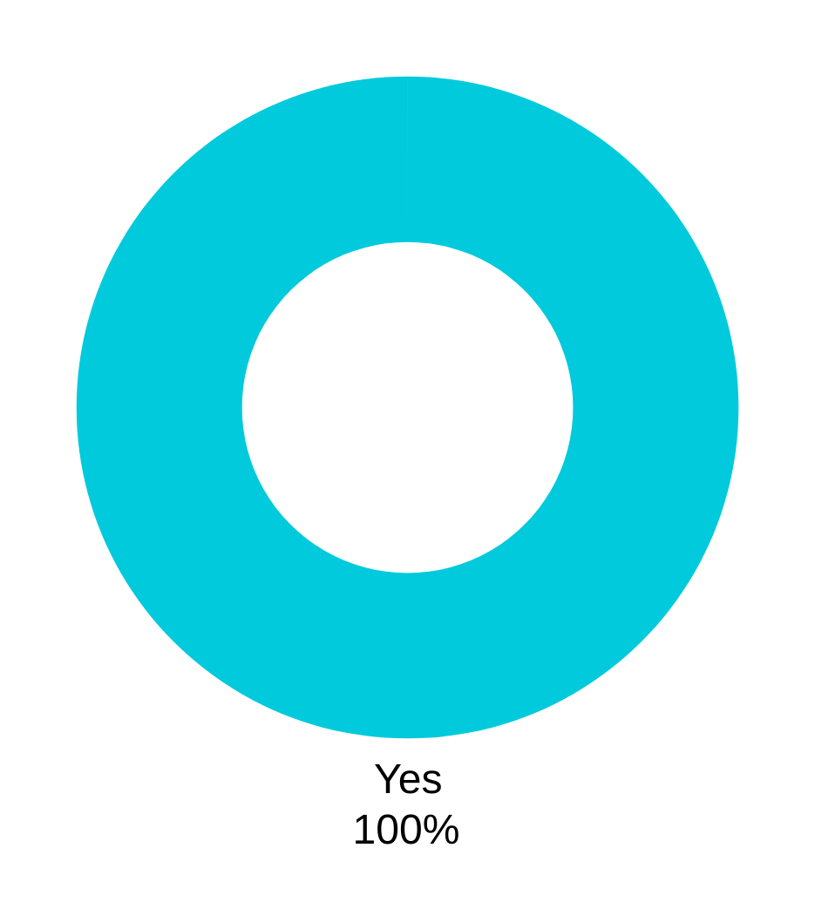
Q19: DO YOU HAVE A PHYSICIAN OR HEALTHCARE PROVIDER?
Powered by

Slide 22
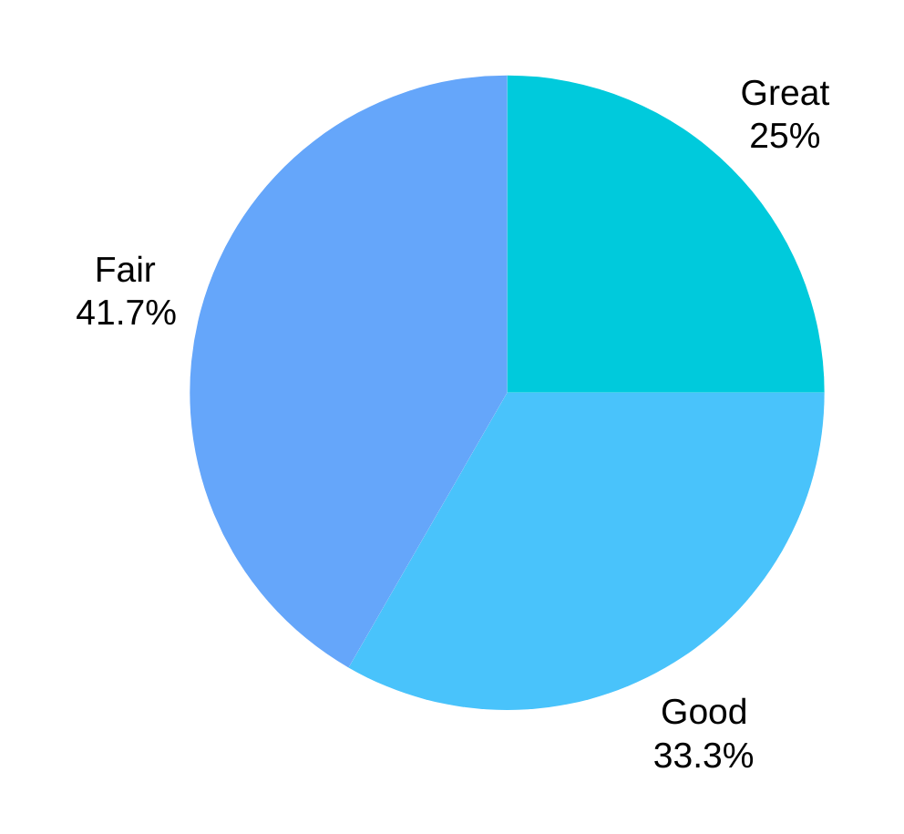
Q20: DO YOU CONSIDER YOUR HEALTH:
Powered by

Slide 23
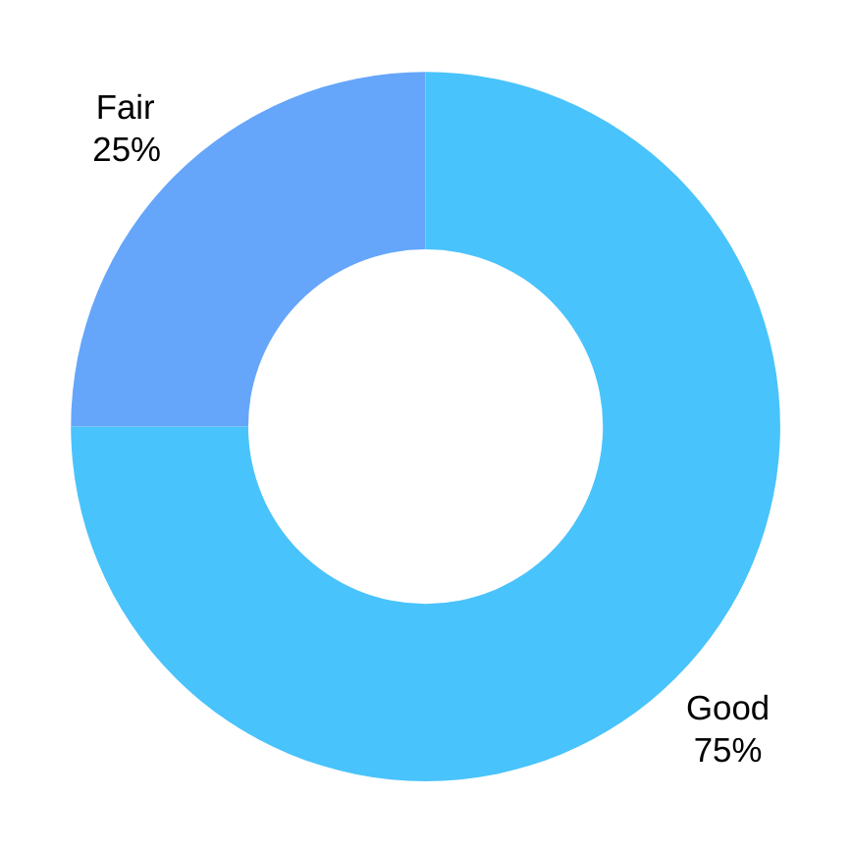
Q21: DO YOU CONSIDER YOUR FAMILY’S HEALTH:

Slide 24
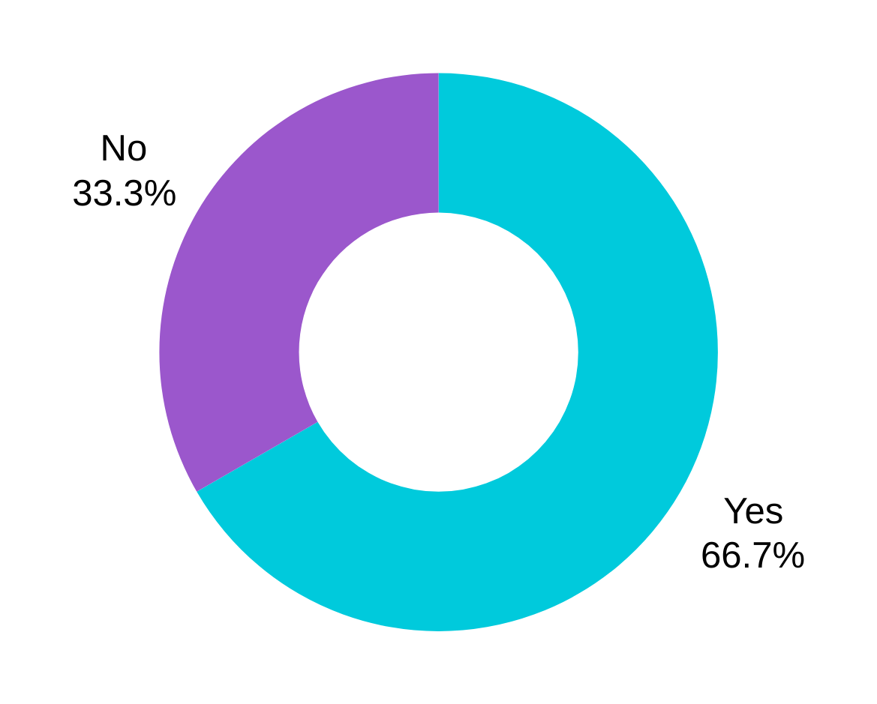
Q22: DO YOU EXERCISE?

Slide 25
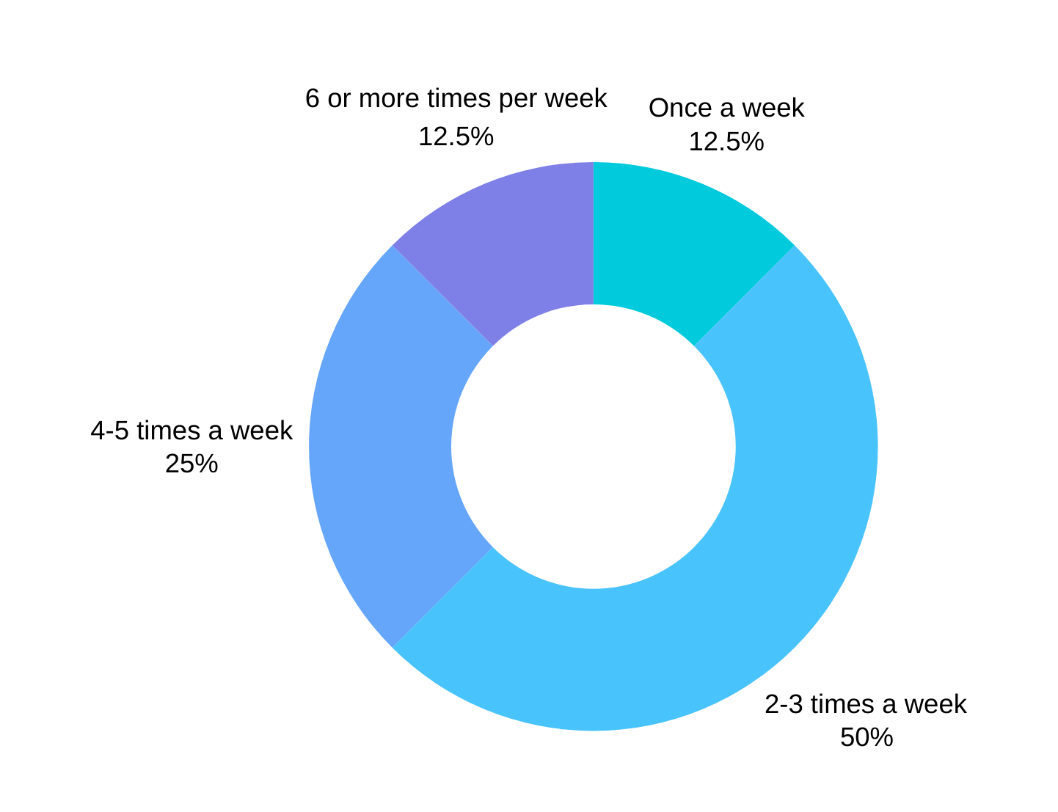
Q23: HOW MANY TIMES A WEEK ?

Slide 26
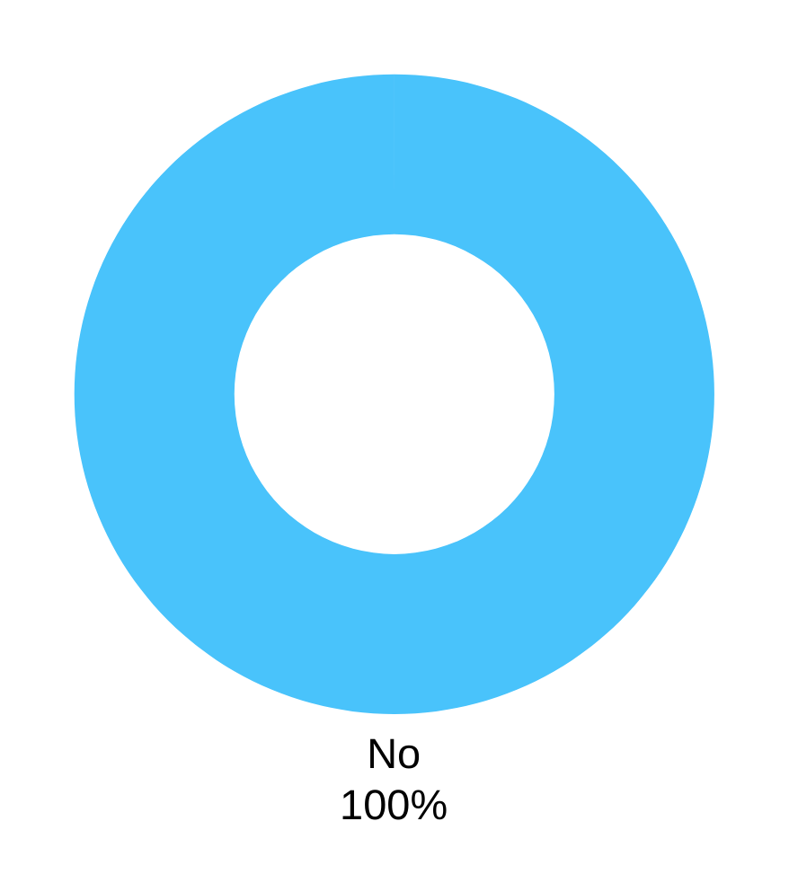
Q24: DO YOU CURRENTLY SMOKE?

Slide 27
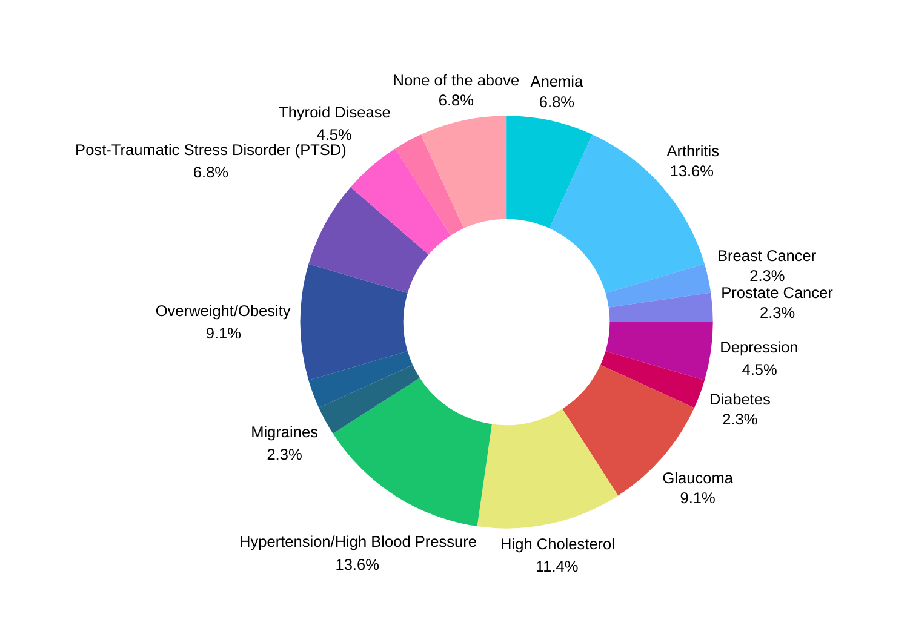
Q25: HAVE YOU BEEN DIAGNOSED WITH ANY OF THE FOLLOWING CONDITIONS?

Slide 28
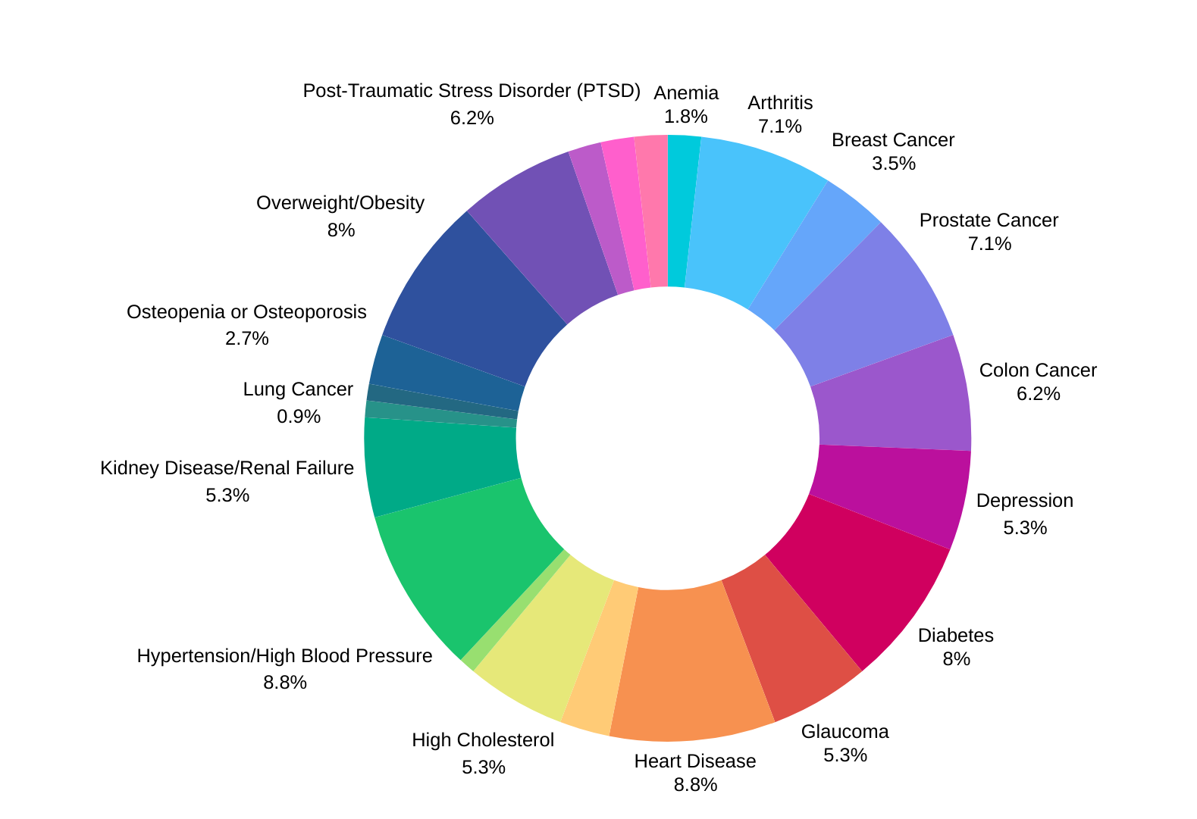
Q26: HAS ANYONE IN YOUR FAMILY BEEN DIAGNOSED
WITH ANY OF THE FOLLOWING CONDITIONS?

Slide 29
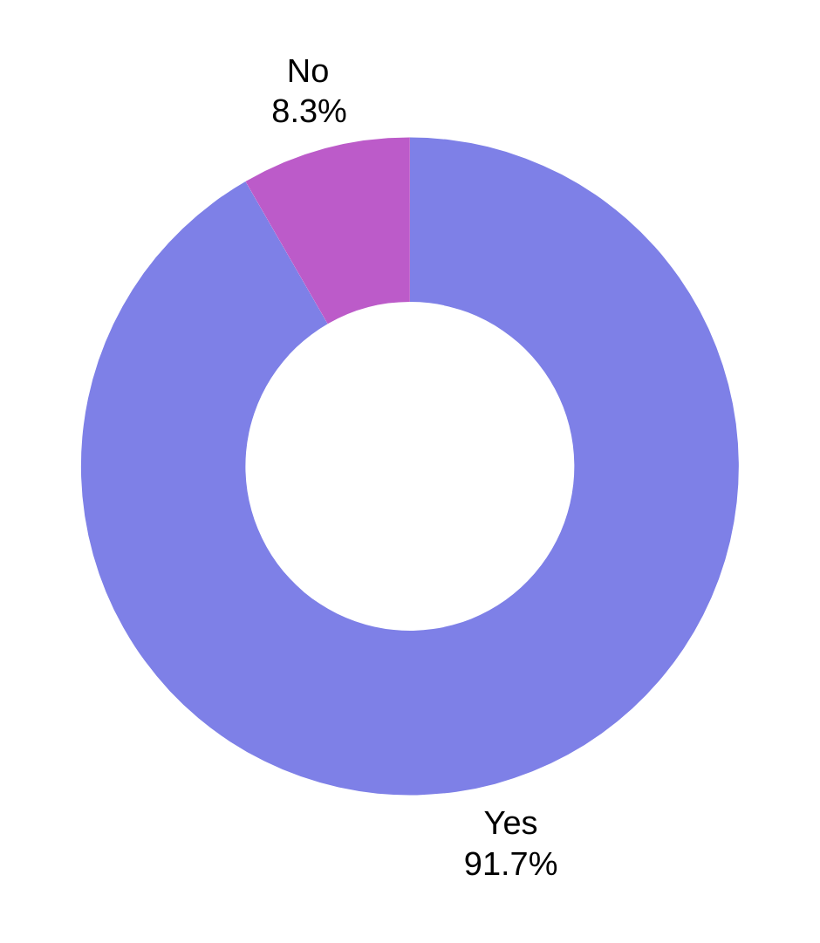
Q27: HAVE YOU BEEN TO A PHYSICIAN OR HEALTHCARE PROVIDER IN THE LAST 2 YEARS FOR ANY EXAMINATION OR HEALTH CONCERN?

Slide 30
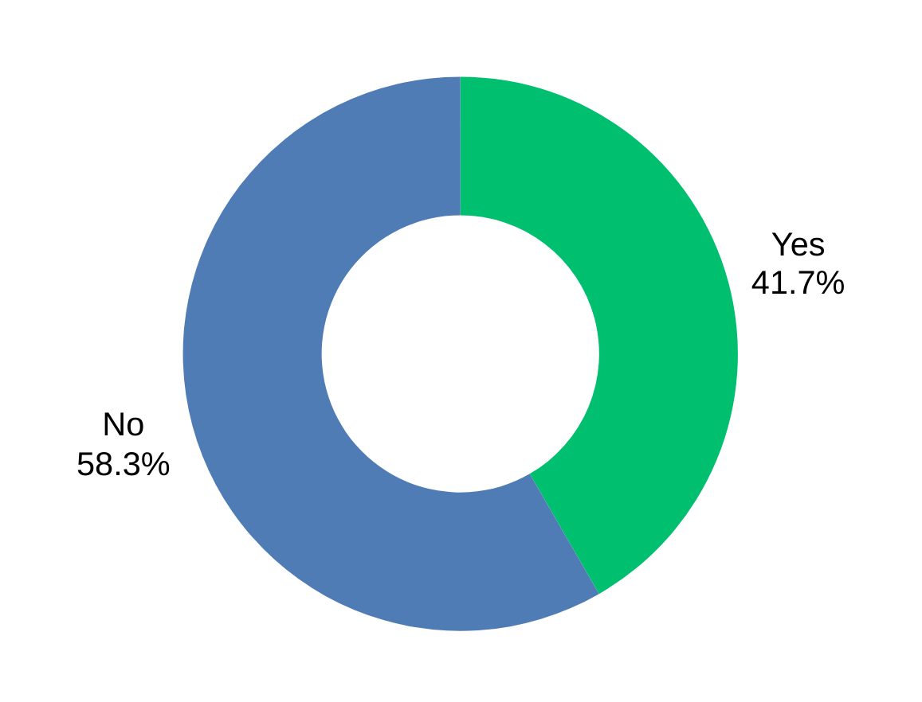
Q28: HAVE YOU SEEN YOUR PRIMARY CARE PHYSICIAN FOR A ROUTINE CHECK UP IN THE LAST YEAR?

Slide 31
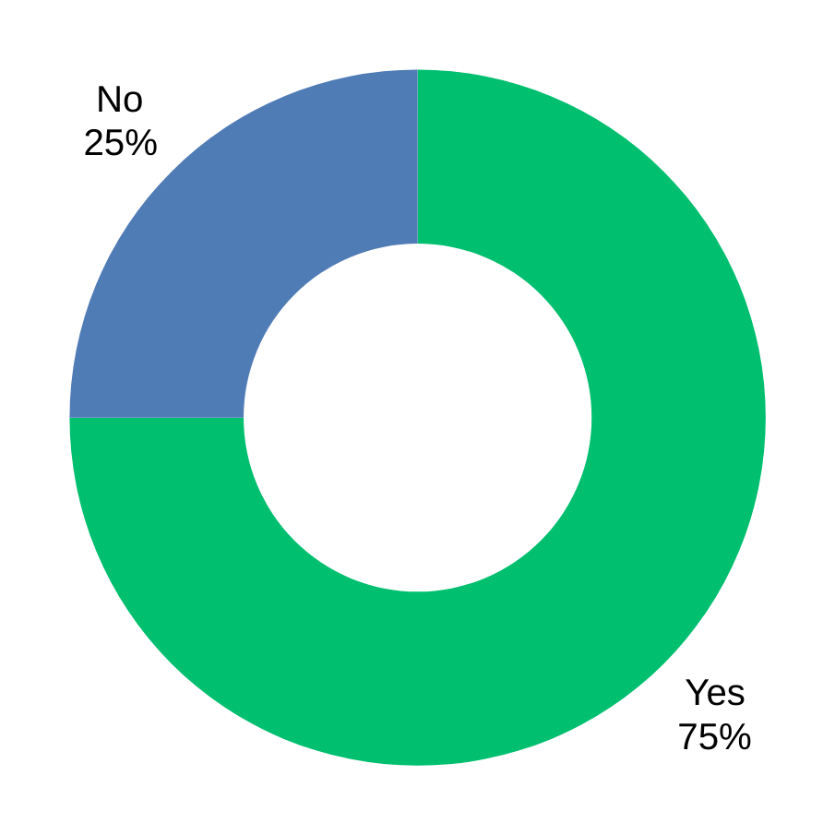
Q29: DO YOU TAKE PRESCRIPTION MEDICATIONS?

Slide 32
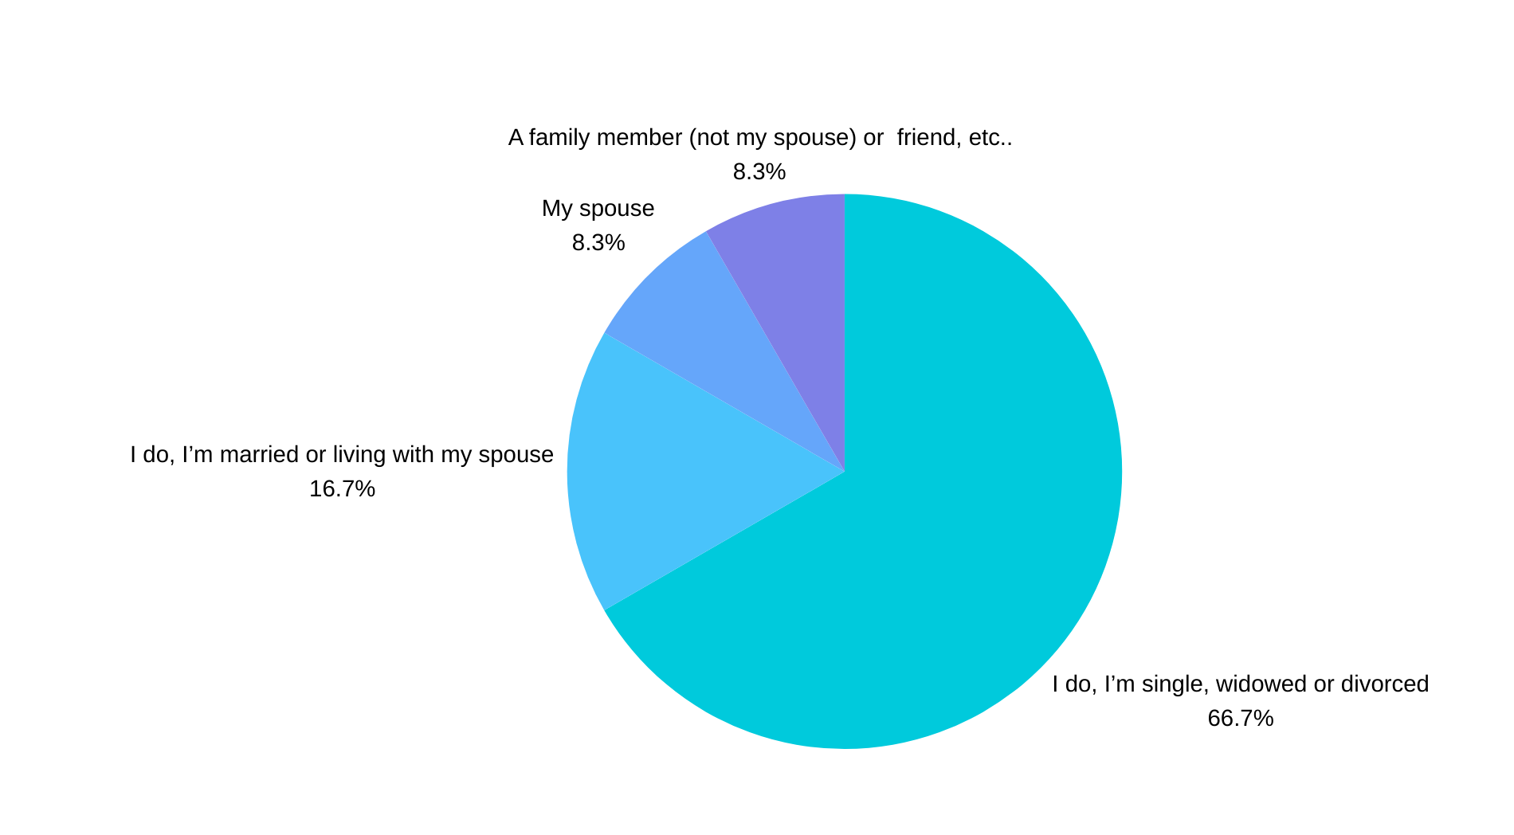
Q30: WHO MAKES THE HEALTH DECISIONS IN YOUR FAMILY?

Slide 33
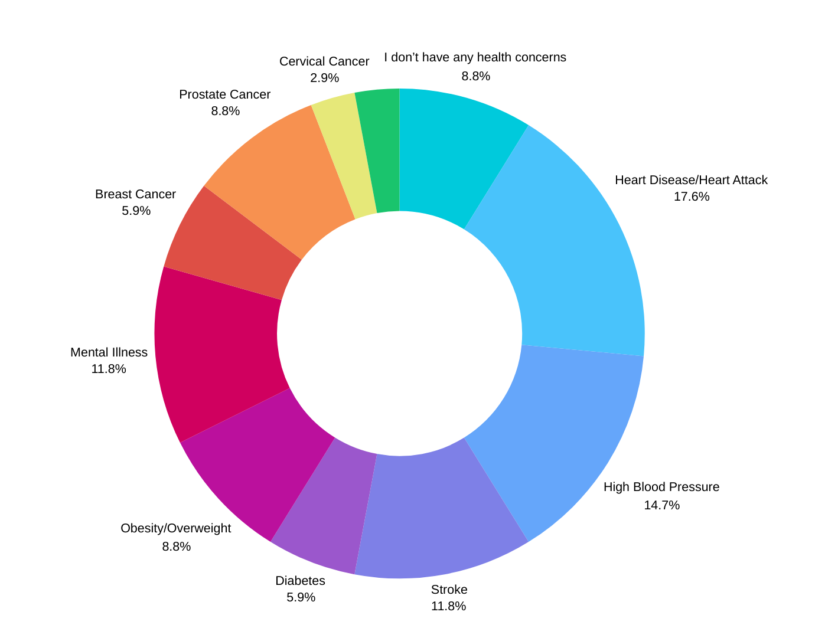
(CHECK ALL THAT APPLY)
Q31: WHAT ARE YOUR BIGGEST HEALTH CONCERNS FOR YOURSELF ?

Slide 34
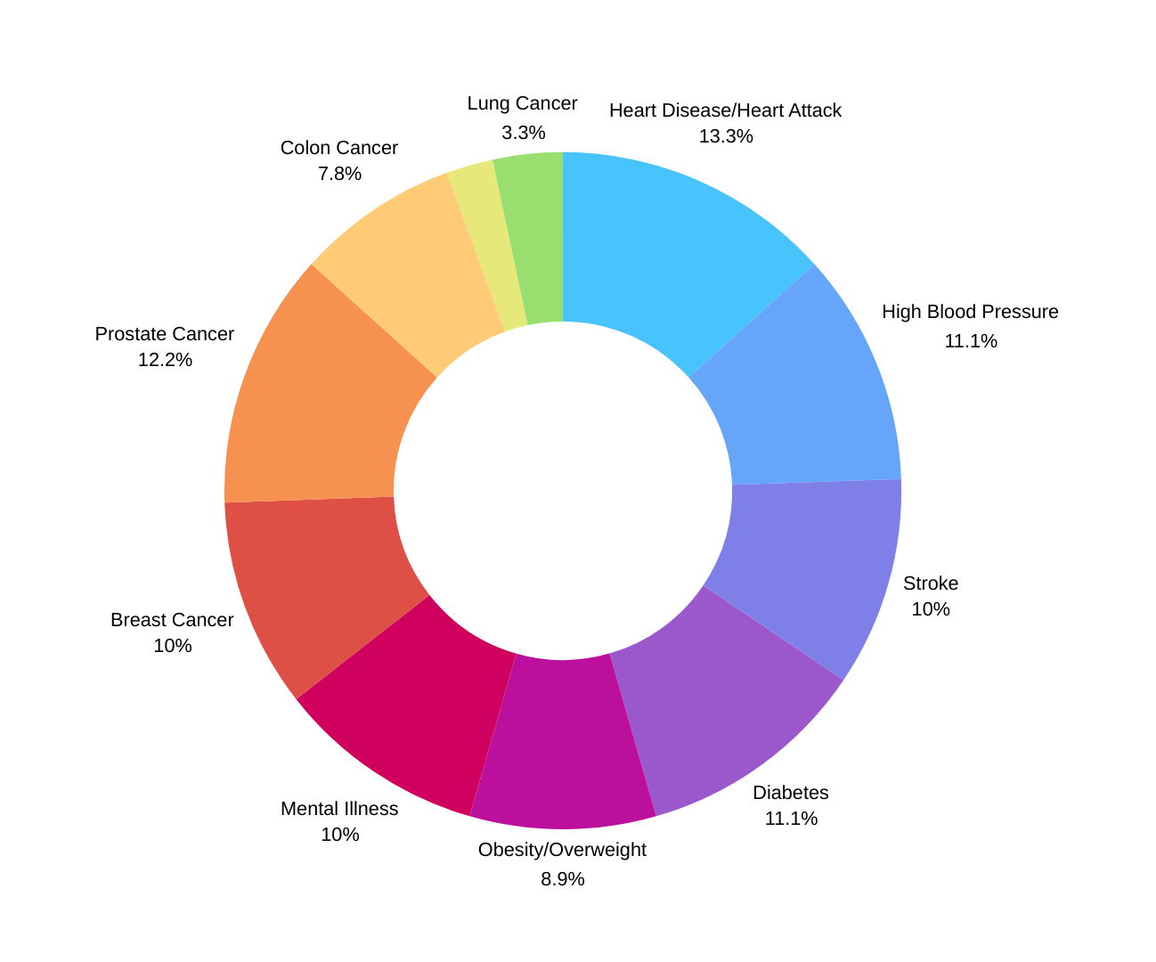
Q32: ARE YOU CONCERNED ABOUT ANY OF THE FOLLOWING HEALTH CONDITIONS FOR YOUR PARENT, SPOUSE, CHILDREN, OR SIBLINGS ? (CHECK ALL THAT APPLY) :

Slide 35
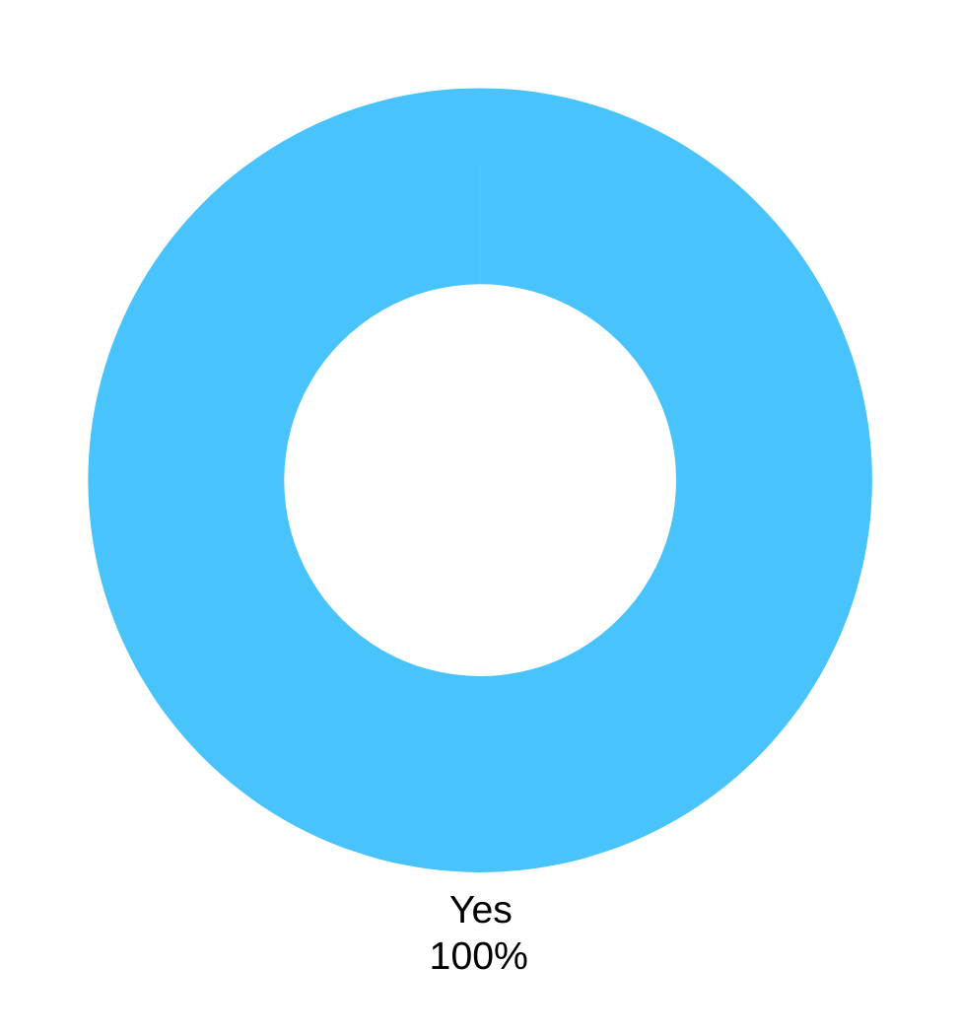
Q33: DO YOU WANT TO IMPROVE YOUR HEALTH?

Slide 36
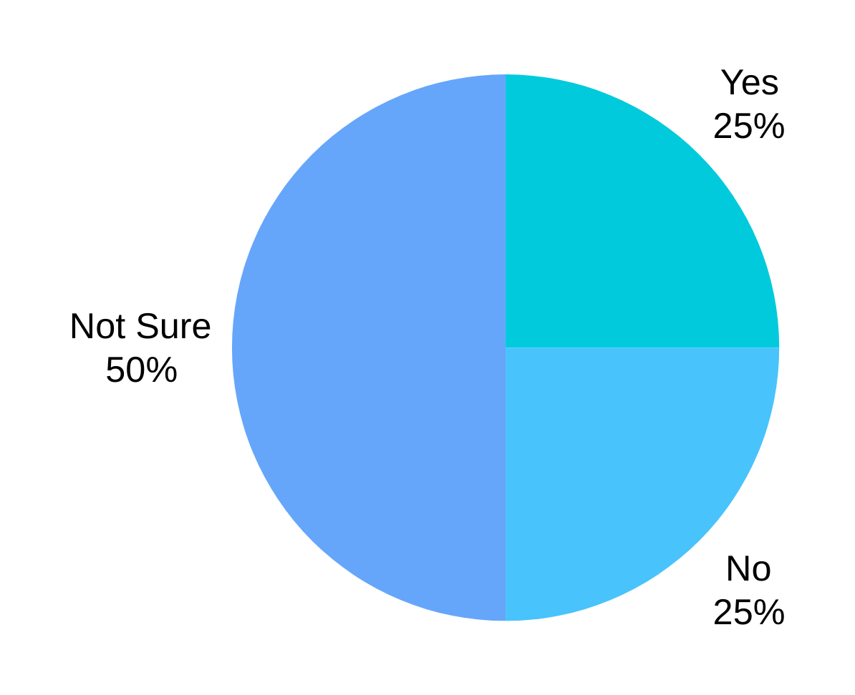
Q34: DO YOU FEEL THAT YOU HAVE THE PROPER KNOWLEDGE AND TOOLS TO IMPROVE YOUR HEALTH?

Slide 37
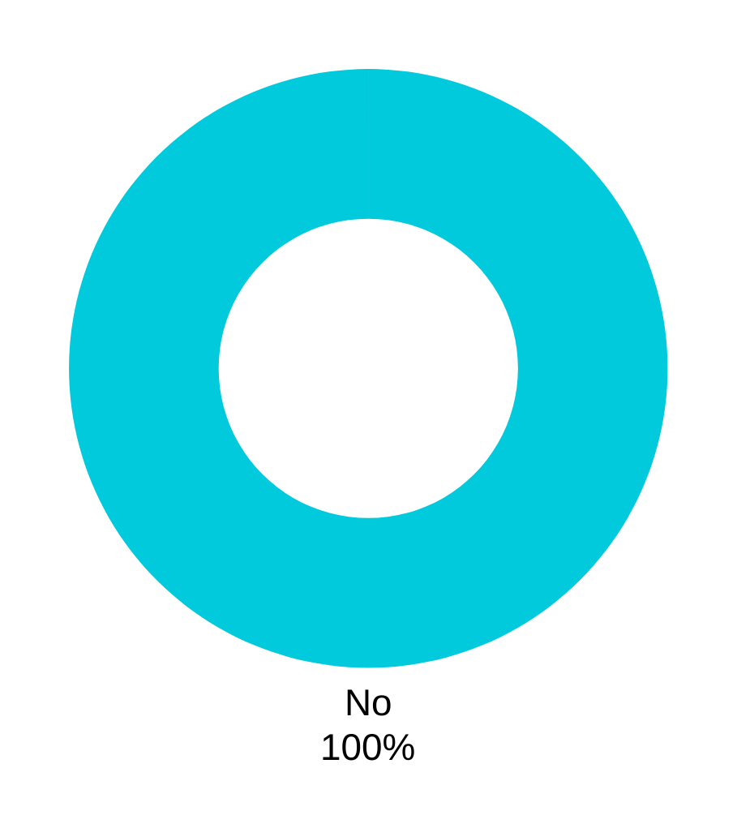
Q35: DO YOU FEEL THERE IS ADEQUATE AVAILABILITY OF HEALTHCARE TO THE RETIRED MILITARY COMMUNITY?

Slide 38
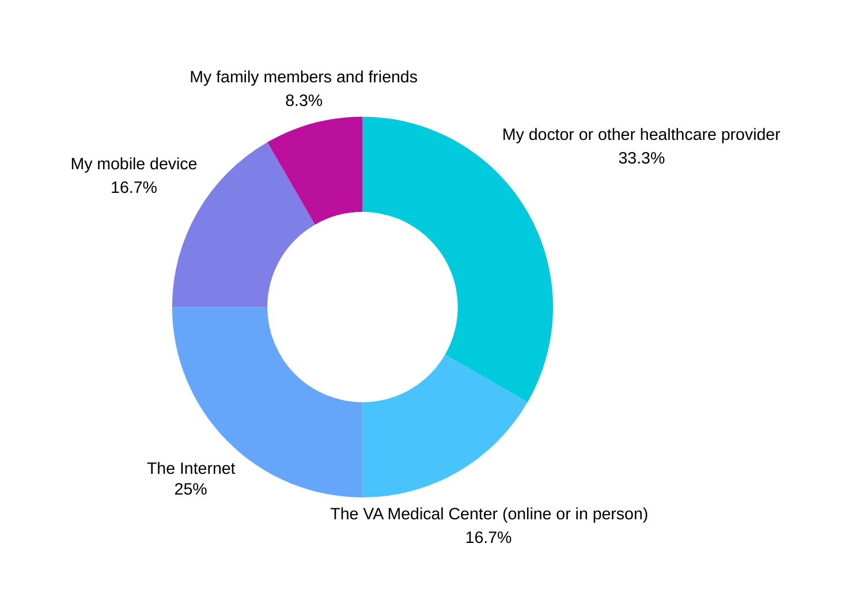
Q36: WHERE DO YOU GET MOST OF YOUR HEALTH INFORMATION?

Slide 39
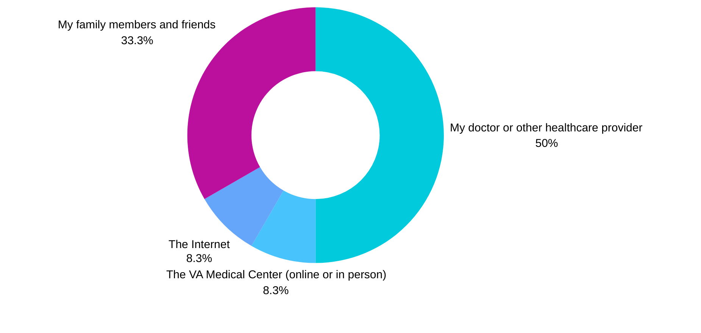
Q37: WHAT SOURCES DO YOU TRUST FOR HEALTH INFORMATION?

Slide 40
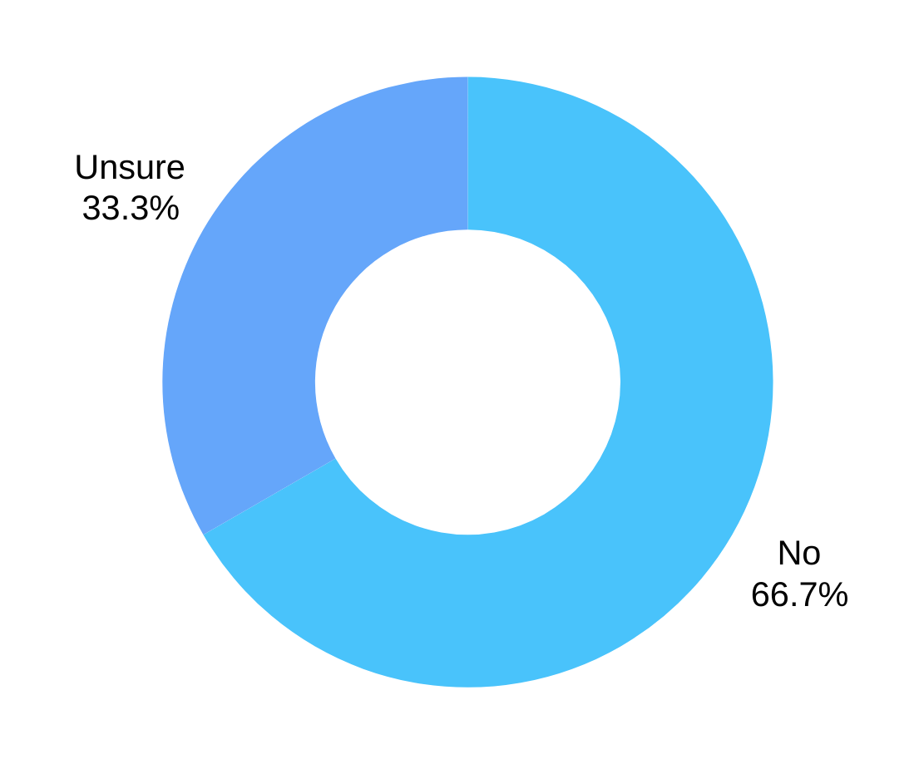
Q38: DO YOU FEEL THAT HEALTH INFORMATION IS TARGETED SPECIFICALLY TO YOU?

Slide 41
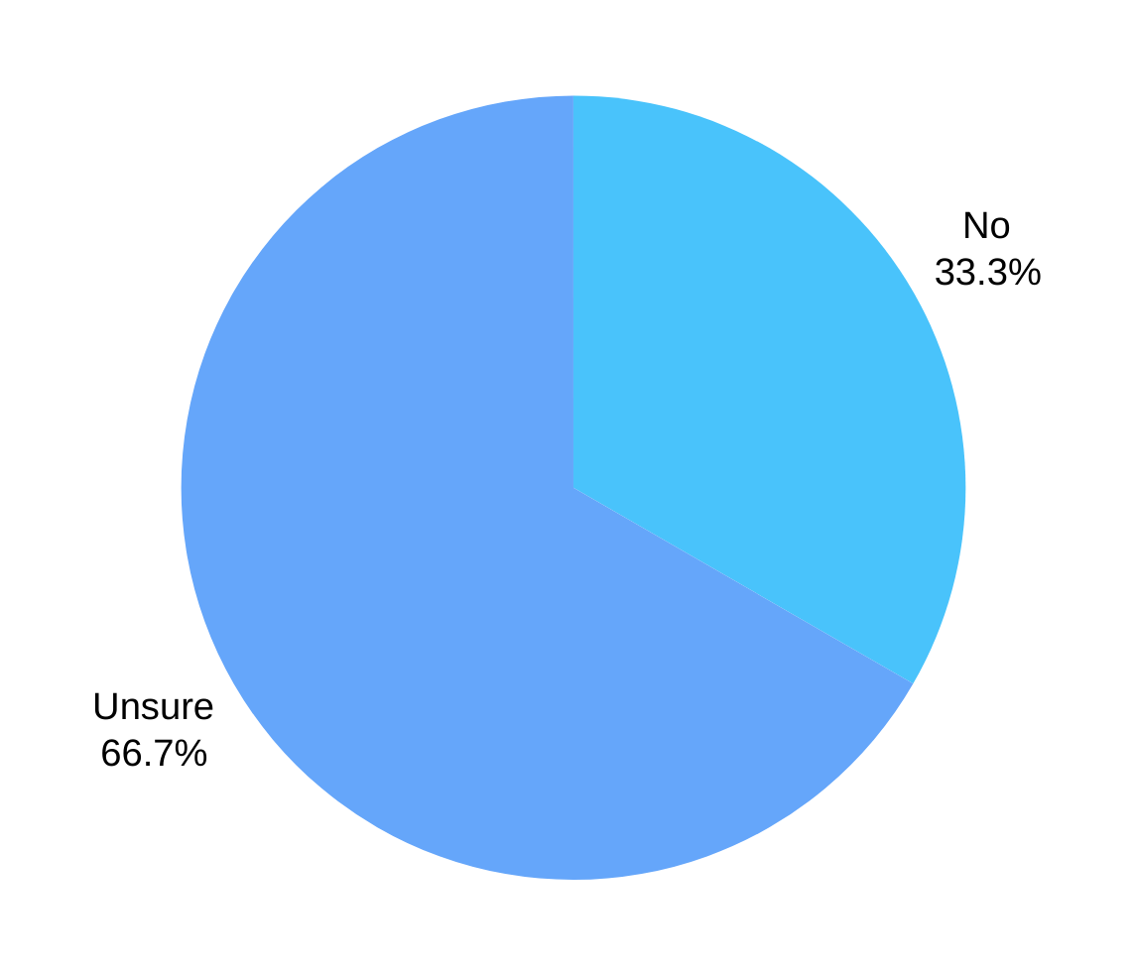
Q39: DO YOU FEEL THAT THERE ARE ENOUGH RADIO SHOWS, TELEVISION SHOWS, WEBSITES, PRINTED MATERIALS, VIDEOS, AND
OTHER MESSAGING IN THE MEDIA REGARDING HEALTH?

Slide 42
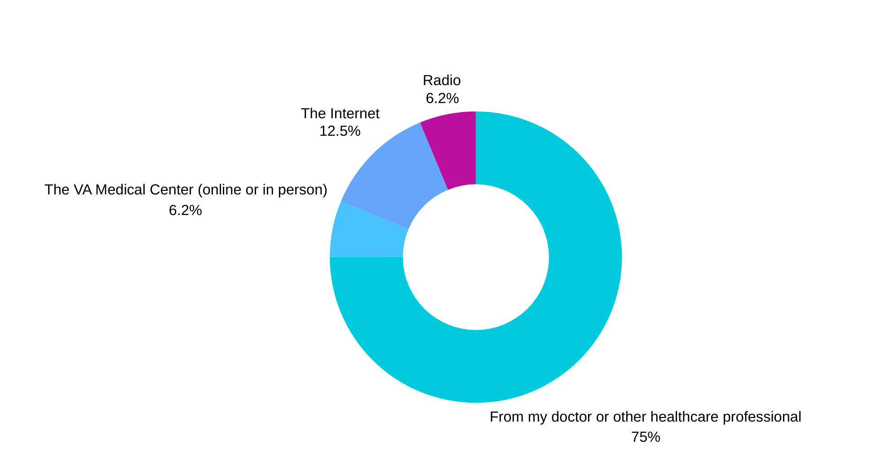
Q40: IDEALLY WHERE WOULD YOU LIKE TO RECEIVE HEALTH INFORMATION?

Slide 43
FOR MEDIA INQUIRIES OR FURTHER INFORMATION, PLEASE CONTACT:
Jerome Williams
Executive Director, The PMW Foundation
Jerome.Williams@thepmwfoundation.org

